Slide 1
Client Site
Report No 300817.01
Radiographic Inspection Report Conveyor CV123
Overland Conveyor System

Slide 2
Initial Image / Data Collection.
No Changes to the Image / data were detected.
No Action is required.
Minor Changes to the Image / data were detected.
These changes are not considered to be of note. The changes will be recorded for
future reference.
Moderate Changes to the Image / data were detected.
These changes are considered to be notable and worthy of inspection.
Major Changes to the Image / data was detected.
These changes are worthy of immediate attention.
Inspection Date: 30st August 2017
Inspection Scan carried out by: James Warbrick B.Eng, MIEAust
$$√$$

Slide 3
Summary
This report details the Continuous Radiography Analysis for Conveyor CV123 Overland system carried out on the 30th of August 2017 utilising a Mobile Continuous Radiography Monitoring System at the clients regional Operations.
It must be noted that arbitrary nomenclature for all splices and belt sections have been utilised due to the absence of branding for all splices and belt sections.
Files utilised being:
Image File:- 2017Aug30-1554_cv123.chs
Belt Sections:
A total of 10 belt sections are noted through the data. All belt section lengths are detailed and will be utilised as the datum for future analysis.
Belt Events:
Numerous damage / broken cords are noted through the data and can be viewed via the belt screen on page 23.
Various portions of the belt have sustained edge damage and loss of edge cords.
No adverse corrosive conditions are noted at this time for any belt sections.

Slide 4
Splice Condition:
A total of 10 splices are noted through the data, 8 of the splices are are left hand leading the remaining 2 are right hand leading.
Scanned trace starts with splice 1 and concludes after splice 1.
All splices are of the same design and have similar patterns to each other but are seen as variable at this time, further imaging will pick up any deviations against what has been recorded to date.
Variations in the make up of the splices relate to centre butt, edge cord distance, cord pitch, cord straightness/alignment and transitions.
A number of splices are noted as having rubber voids at the cord ends and lack of infill rubber along adjacent cord members.
Profile data:
No profile data recorded for this belt, we cannot advise as to the impact a reduced cover will have on the remaining life of the belt.
Recommendations:
Given the current makeup and condition of the splices we would recommend that an appointed system be installed to monitor periodically as deemed necessary.
Visually inspect / review all anomalies noted through the report in order of severity and take appropriate steps as required.
Report all repairs carried out to allow inclusion into subsequent reports and updates.
Continue to monitor using appropriate equipment to track and trend event frequency and severity.

Slide 5
1.0 Introduction
At the request of the client an initial scan of CV123 was undertaken using Mobile Continuous Radiography Equipment on the 30th August 2017 to determine the condition and suitability for continued service.
The inspection was undertaken in accordance with the Conveyor Health Services Condition Monitoring Program.
Note: Some belt sections may be a result of subsequent splicing within the original belt lengths provided after install.
2.0 Scope of Work
The inspection involved the following activities:
2.1 Comparative Inspection
Continuous Radiography & imaging was carried out to Splices and All Belt sections.

Slide 6
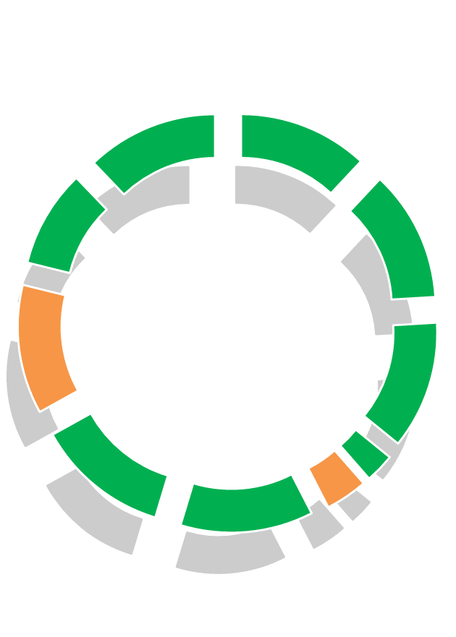
Cord Condition
Splice 1
Splice 10
Splice 2
Name | Length
Splice 1 | 142.73
Splice 2 | 144.57
Splice 3 | 140.84
Splice 4 | 32.32
Splice 5 | 46.33
Splice 6 | 146.07
Splice 7 | 146.48
Splice 8 | 142.29
Splice 9 | 107.45
Splice 10 | 145.04
Splice 9
Splice 3
Splice 8
Splice 4
Splice 5
Splice 7
Splice 6

Slide 7
3.0 Results
3.1 List of Events:
The following pages lists all the events in belt running order noted through the radiography. This listing summarises the position of Events with reference to the number of cords / rubber damaged.
Our policy in terms of removal of events is based on a 10% limit against the total number of cords within a belt.
Key:
Events listed in red are recommended for removal.
Events listed in orange are recommended for inspection and repair as necessary.
Events listed in blue require close monitoring, visual, MFL, X-ray or otherwise.
Events listed in green require no action to be taken at this time.

Slide 8
Event Condition
Event 1
Event 2
Event 3
Event 4
Event 5
Event 6

Slide 9
Event Condition
Event 7
Event 8
Event 9
Event 10
Event 11
Event 12

Slide 10
Event Condition
Event 13
Event 14
Event 15
Event 16
Event 17
Event 18

Slide 11
Event Condition
Event 19
Event 20
Event 21
Event 22
Event 23
Event 24

Slide 12
Event Condition
Event 25
Event 26
Event 27

Slide 13
Event Condition
Event 28

Slide 14
Event Condition
Event 29

Slide 15
Event Condition
Event 30

Slide 16
Event Condition
Event 31

Slide 17
Event Condition
Event 32

Slide 18
Splice 1
Splice 2

Slide 19
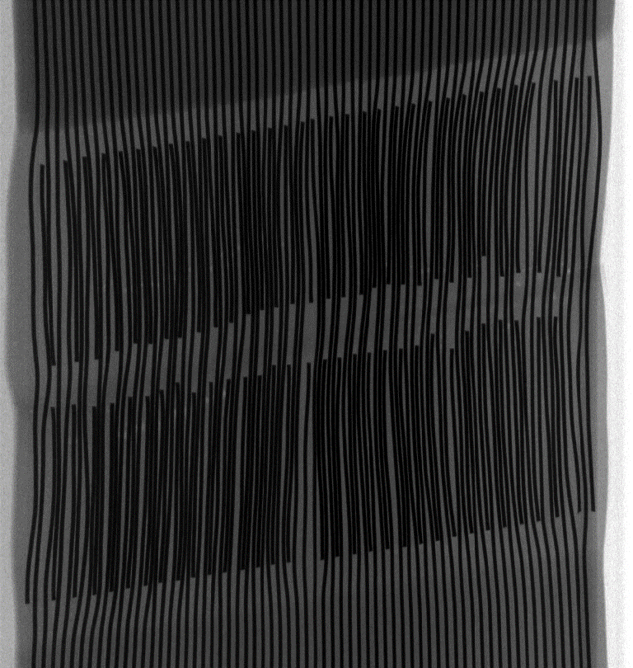
Splice 3
Splice 4

Slide 20
Splice 5
Splice 6

Slide 21
Splice 7
Splice 8

Slide 22
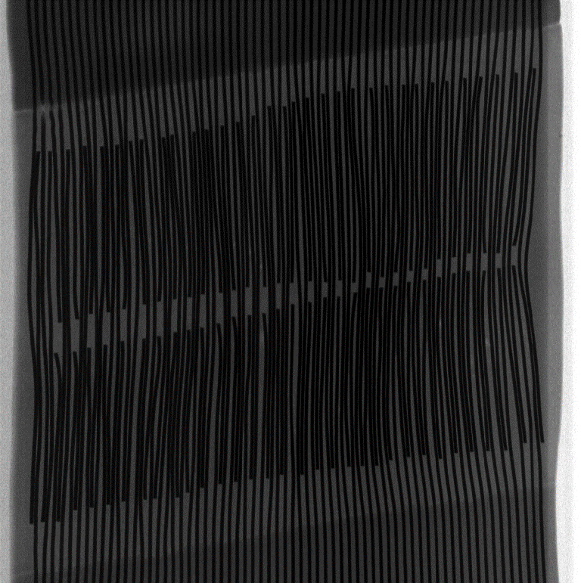
Splice 9
Splice 10

